Slide 1
Sparse Matrix

Slide 2
SPARSE MATRIX
Sparse Matrix is a matrix populated primarily with zeros.
sparse….. Many elements are zero
dense ....few elements are zero

Slide 3
Representation Of Unstructured Sparse Matrices
Represented by a two-dimensional array.
Sparse matrix wastes space.
Can be represented as Single linear list in row-major order.
Each nonzero element is represented by a triple
(row, column, value)
The list of triples may be an array list or a linked list (chain)

Slide 4
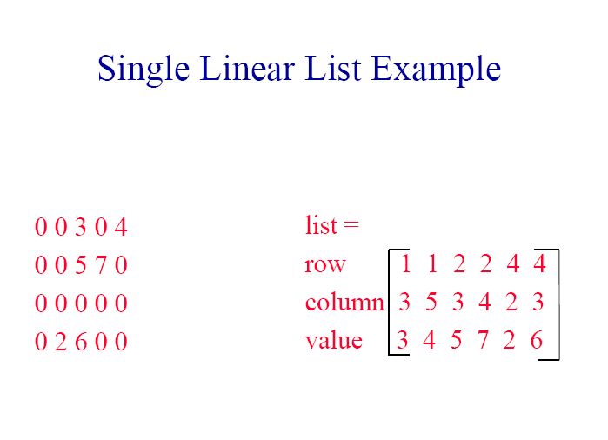

Slide 5
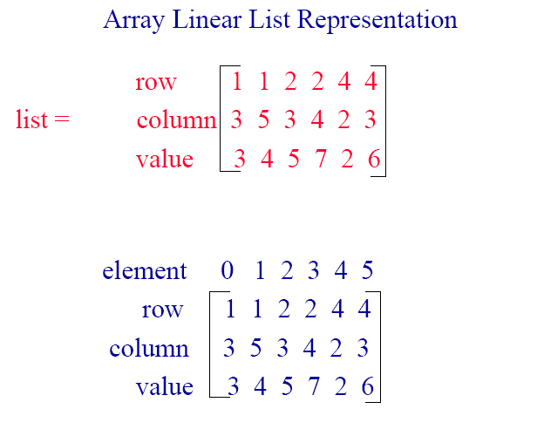

Slide 6
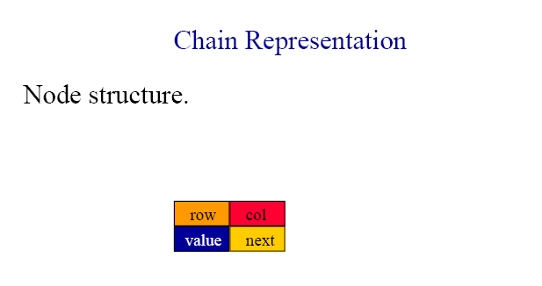

Slide 7
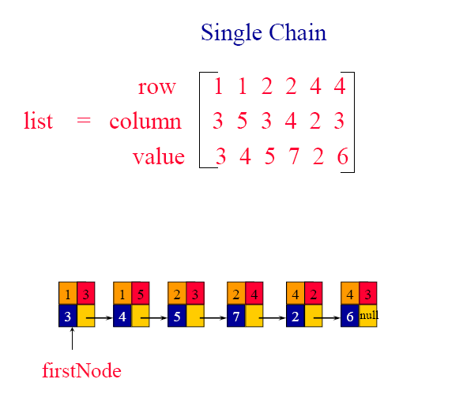
struct node
{
int row;
int col;
int data;
struct node *link;
}

Slide 8
Sparse Matrix using single linked list
printf("\nSparse Matrix using Linked List\n");
printf("\n Enter the number of rows of the matrix:");
scanf("%d",&m);
printf("Enter the number of columns of the matrix:");
scanf("%d",&n);
printf("Enter the elements:");
for(i=0;i<m;i++)
{ for(j=0;j<n;j++)
{scanf("%d",&a[i][j]);}}
#include<stdio.h>
struct node
{
int row;
int col;
int data;
struct node *link;
}*head=NULL,*curr=NULL,*p=NULL;
void main() {
int i,j,m,n,a[50][50];

Slide 9
for(i=0;i<m;i++)
{ for(j=0;j<n;j++)
{
if(a[i][j]!=0)
{
curr=(struct node*)malloc(sizeof(struct node));
curr->row=i;
curr->col=j;
curr->data=a[i][j];
curr->link=NULL;
if(head==NULL)
head=curr;
else
{
p=head;
while(p->link!=NULL)
p=p->link; p->link=curr;
}
}
}}

Slide 10
printf("\nSparse matrix using linked list:\nRow\tColumn\tElement\t\n");
p=head;
if(head==NULL)
printf("\nSparse matrix empty!\n");
else
{ while(p->link!=NULL)
{
printf("%d\t%d\t%d\n",p->row,p->col,p->data);
p=p->link;
}
printf("%d\t%d\t%d\n", p->row, p->col, p->data);
}
getch();
}

